Slide 1

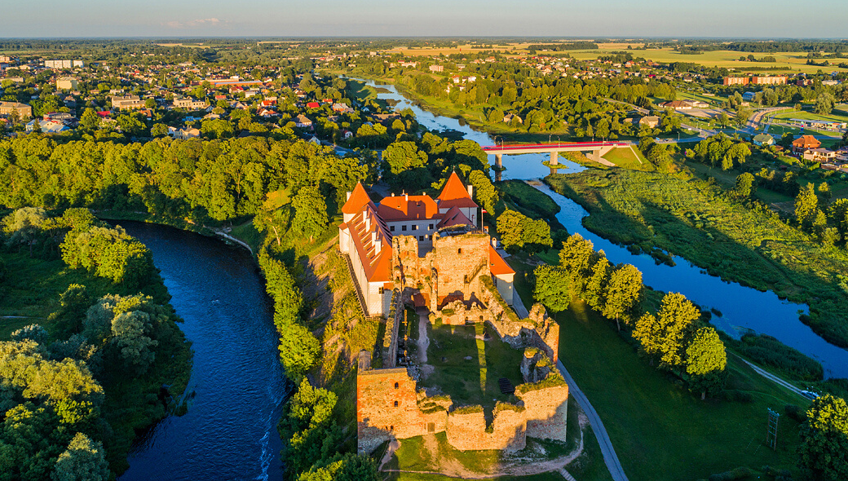
Bauska Live
BAUSKAS LITTLE HELPERS

Slide 2
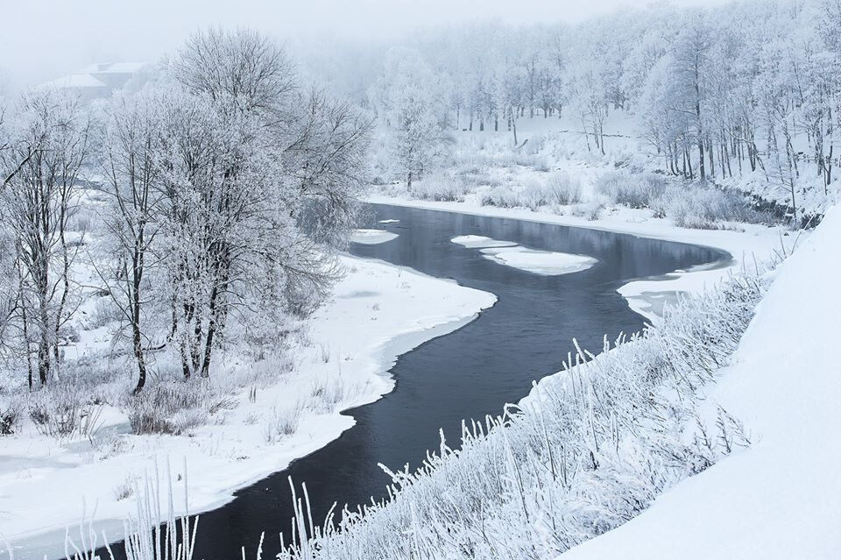

Initial idea
Now
ONE LONG COMMERCIAL FOR BAUSKA ABOUT ITS BUSINESSES AND PLACES TO SEE
MULTIPLE SHORT VIDEO COMMERCIALS;
THUS REFLECTING THE DIVERSITY OF BAUSKA OFFERINGS

Slide 3




INITIAL VISIT IN AUGUST
the lack of any visualizations of the city
MEETINGS WITH MUNICIPALITY
decision to adapt by creating fall/winter season videos

Slide 4
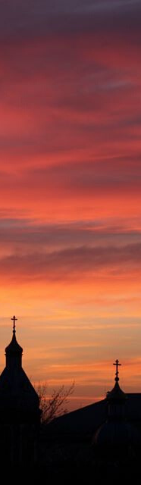
Testing our solution
FEEDBACK ON OUR VIDEOS AND FROM BUSINESSES
STATISTICS OF THE PAGE AND THE VIDEO THROUGH THE SOCIAL MEDIA PLATFORMS
GOOGLE ANALYTICS TO SEE THE CONVERSION RATE

Slide 5
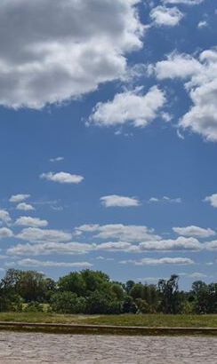
COMMUNITY OF BAUSKA
PROJECT MANAGERS
MEDIA
Not enough presentable information on Bauska
Having not enough tourists come toBauska
Managing the team
FUTURE VISITORS OF BAUSKA
INITIAL KEY STAKEHOLDERS
PROJECT TEAM
working to together and managing their time accordingly
Not knowing tourist attraction inBauska’s municipality

Slide 6
264 page likes
FACEBOOK PAGE

Slide 7
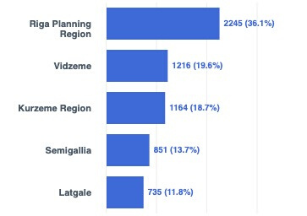
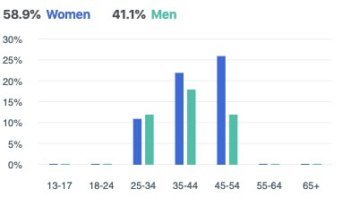

Slide 8
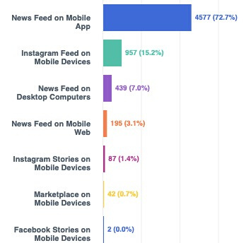

Slide 9
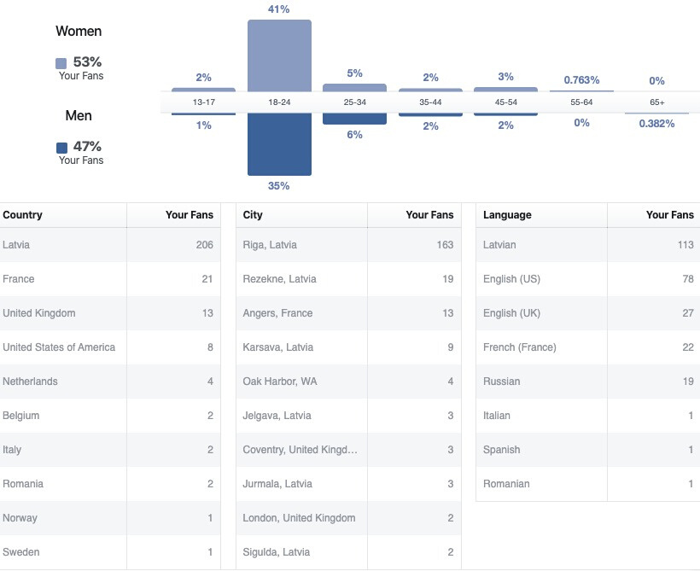

Slide 10
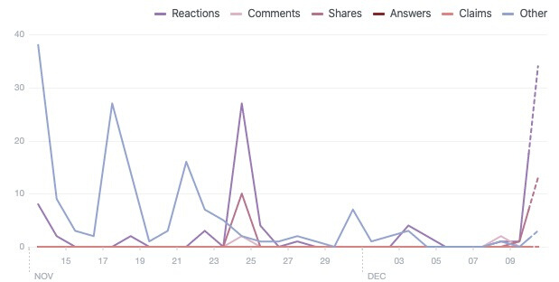
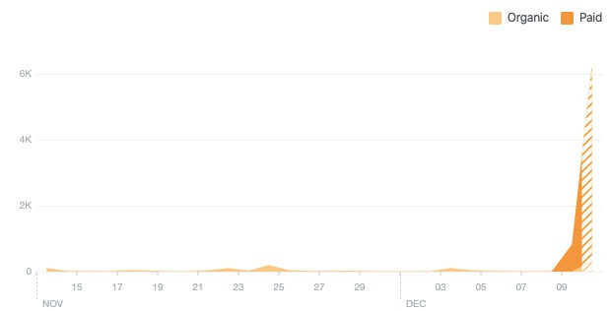

Slide 11





Official Bauska's social media marketing channel
Funds from Bauska’s municipality to invest
Facebook or Google marketing
A "city'' Live movement

Slide 12
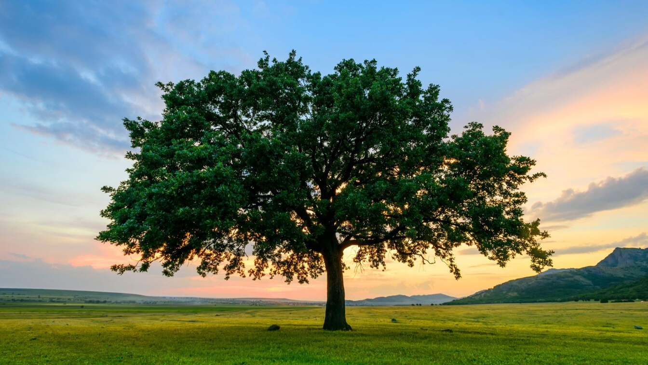


work
work
work
work
work
work

Slide 13
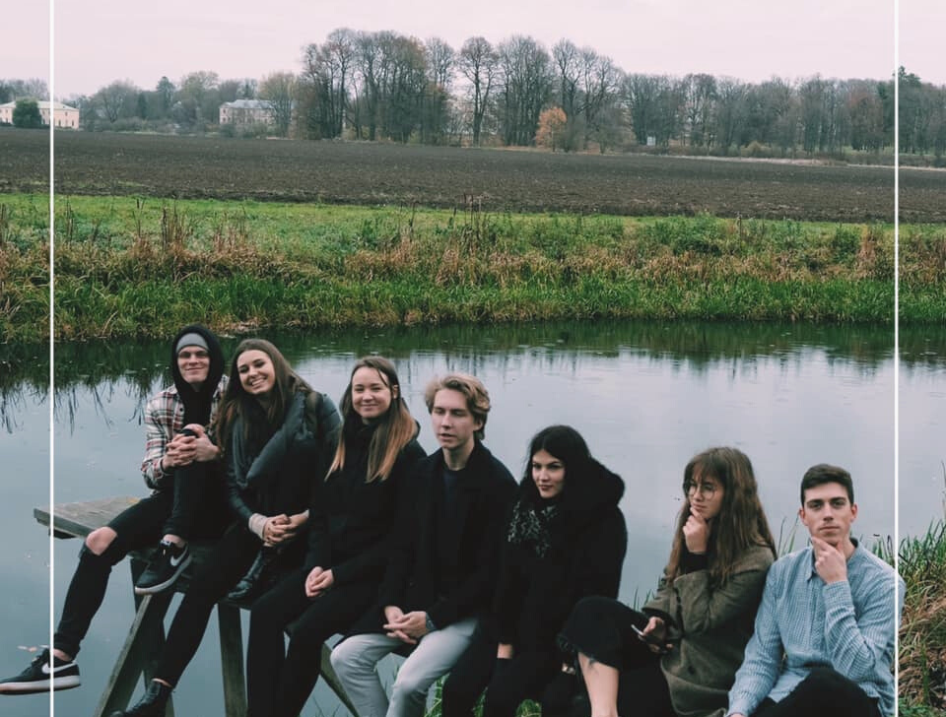
LESSONS= LEARNED!
- Time management is key;
- PLANNING!
- Back-up plan ;
- It is not enough with JUST an idea;
TEAM WORK! TEAM WORK! TEAM WORK!

Slide 14
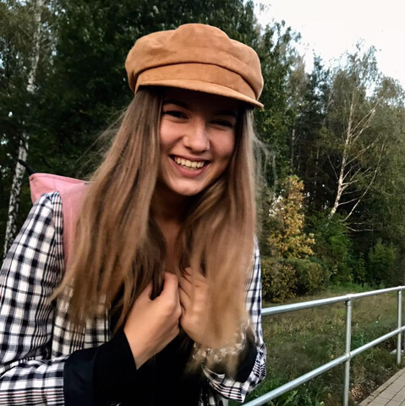
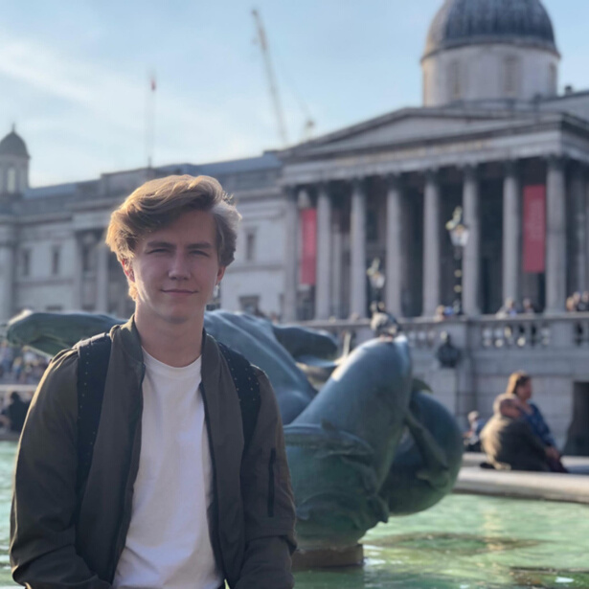

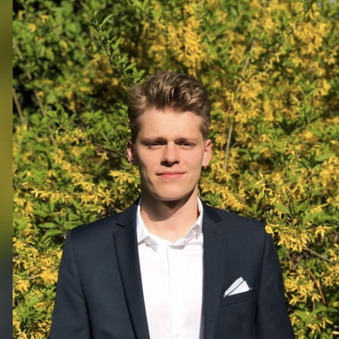
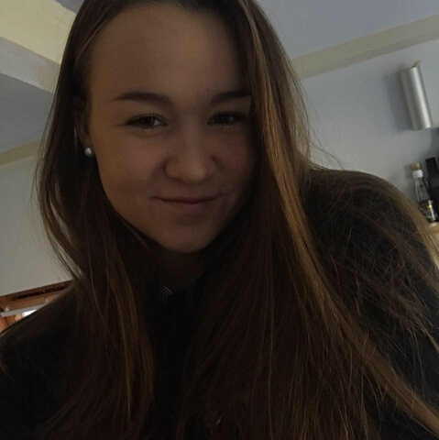
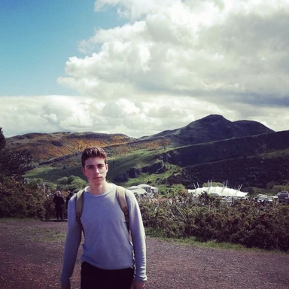
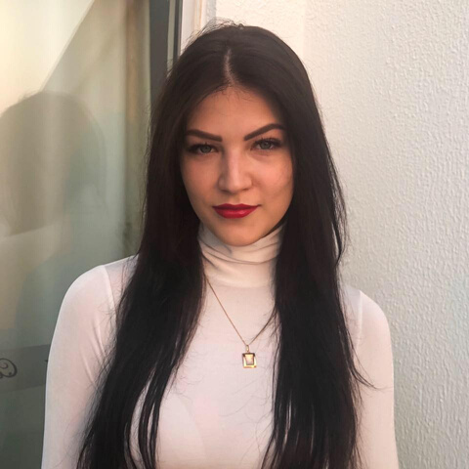
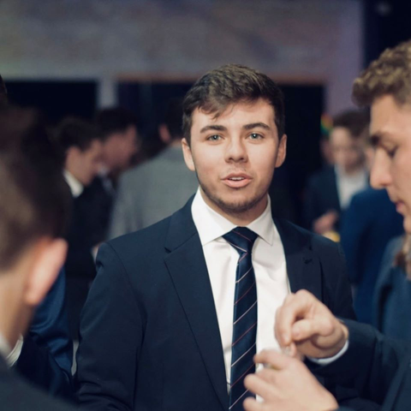
TEAM
ALISE GROTA
EDUARDS TAURENS
ANETE GRAŽULE
DĀVIS ŽILDE
Project Manager
| Social media |
Project Manager
| Content management |
Communication Manager
| Customers and communication |
Communication Manager
| Customers and communication |
LĪVA LIEPIŅA
MATĪSS RUTKS
SIGITA PUNDURE
MATHIEU LUCAS
Project Team Member
| Design and User Experience |
Video editor, content creator
| Video editing, Software |
Project Team Member
| Design and User experience |
Video creator
| Video edting, Software |

Slide 15
Get in touch!
PHONE NUMMBER
+ 37125144040
EMAIL
bauskalive@gmail.com

